Slide 1
Increasing Patient Engagement & Personalised Healthcare
We’ve Got Guts!!

Slide 2
Challenge
Empower patients to create personalised solutions to their own diseases.
Patient Reported Outcomes (PROs) and correlate this with additional data sourced from wearable tech.
Simple and effective visualisation of data for both clinicians and patients.
Inflammatory Bowel Disease is our focus:
Underuse of health care services – lack of engagement
Poor experience at transition and loss to follow-up
Non-adherence with medications

Slide 3
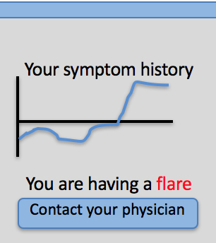
What Benefits We Provide
Empowering patients through technology – Modern Healthcare
Reduces load on Gastroenterologist clinics
Increased Engagement and Patient Feedback
Additional Data and Correlations
Increased patient outcomes
Tailored treatments and recommendations

Slide 4
Solution
Android Mobile App
Secure API
MySQL database
Clinician data visualisation
Patient data visualisation portal

Slide 5
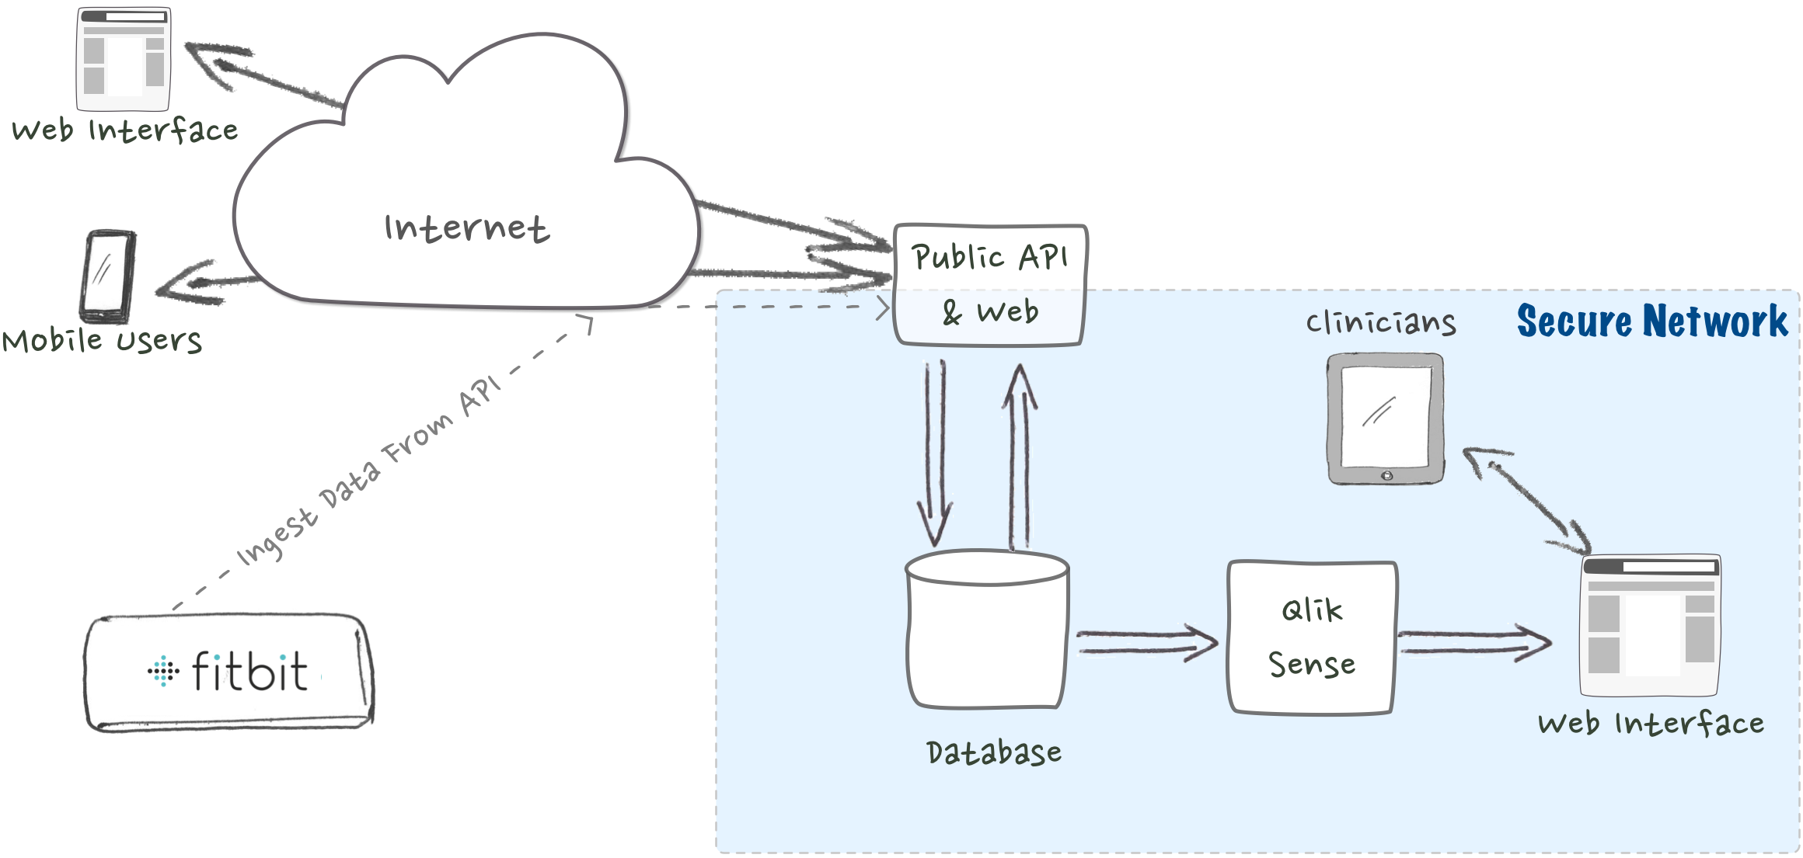
Data Flow

Slide 6
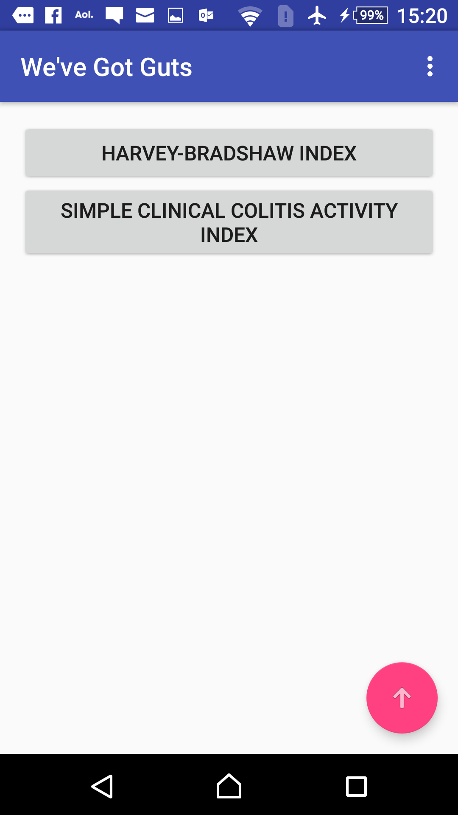
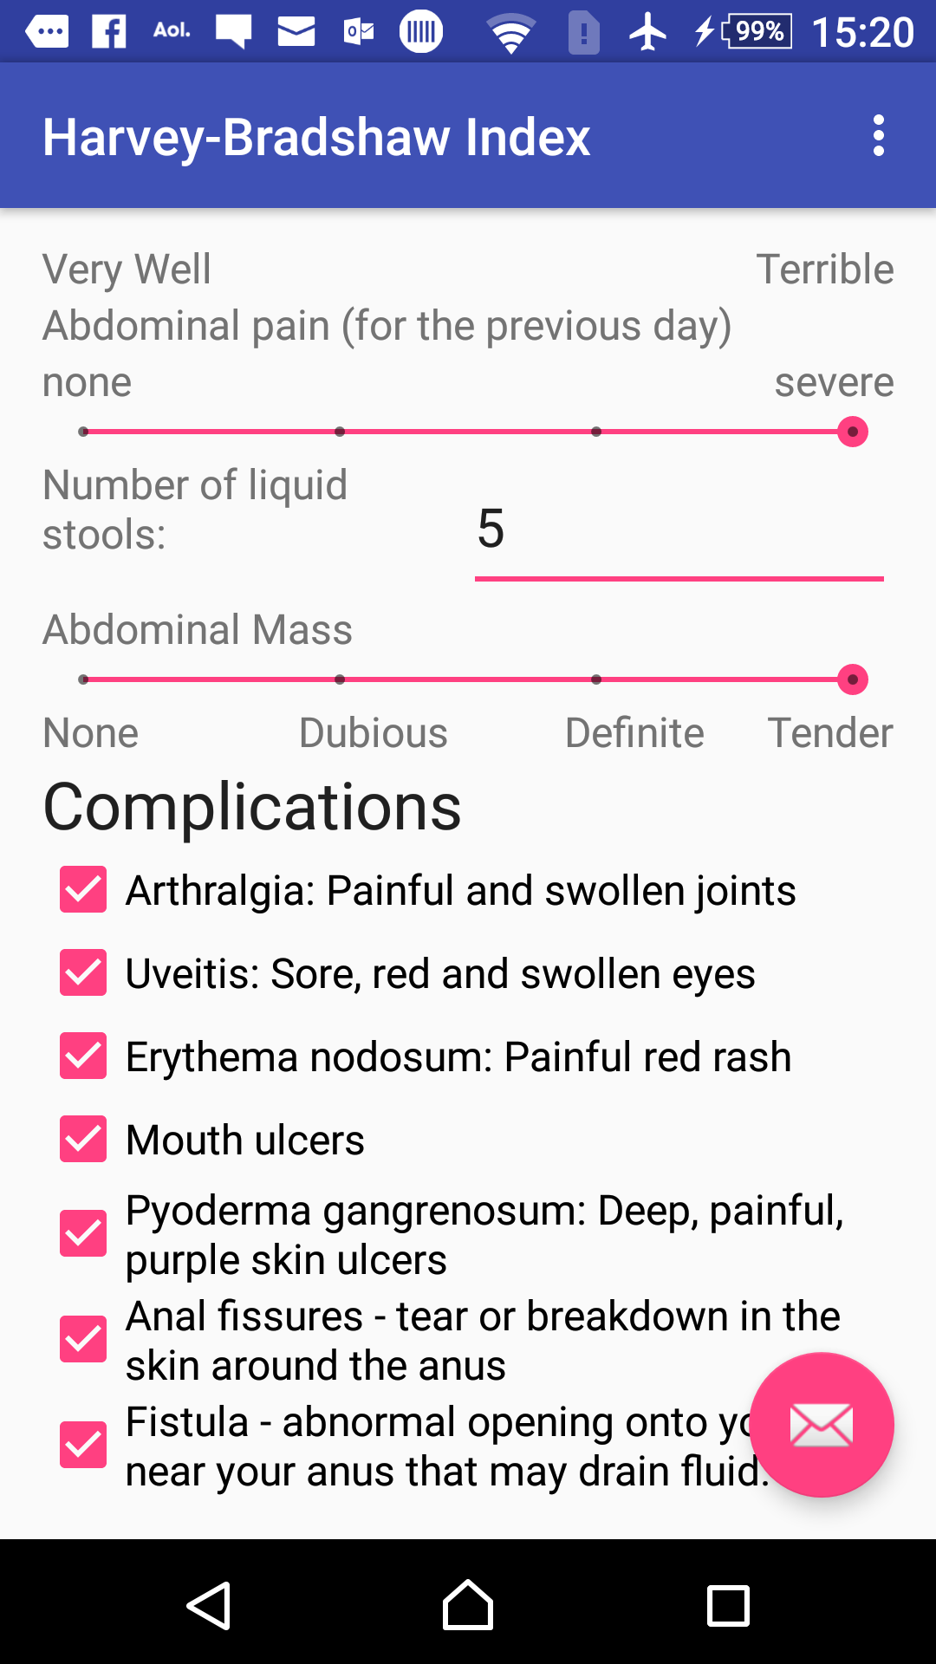
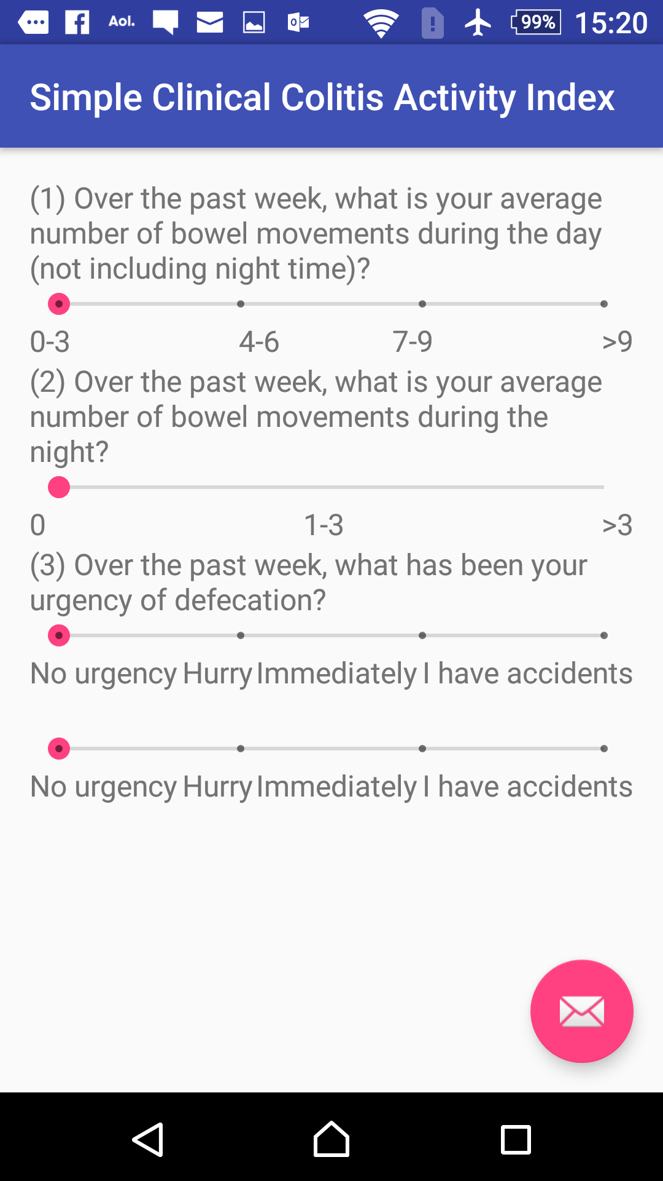
Android Application

Slide 7
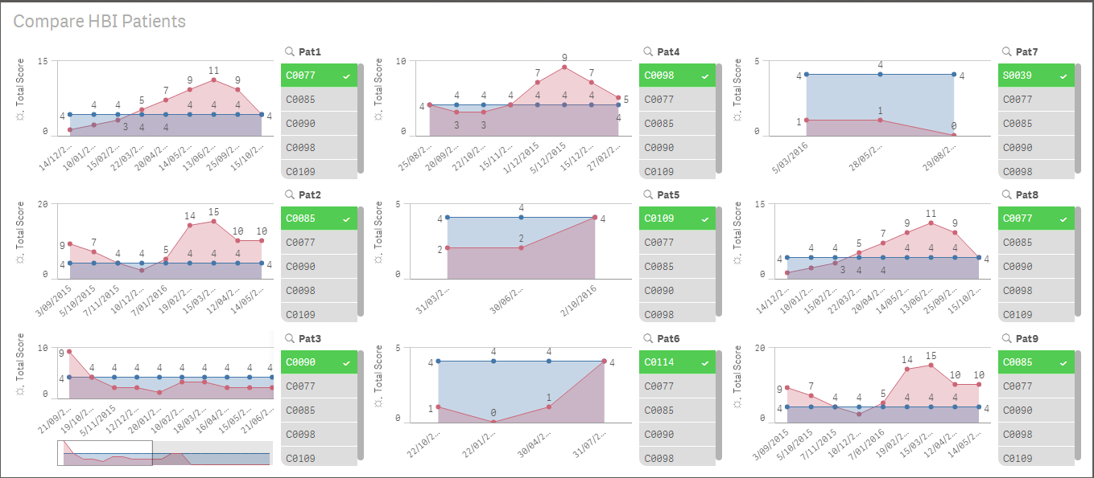
Clinician Insights

Slide 8
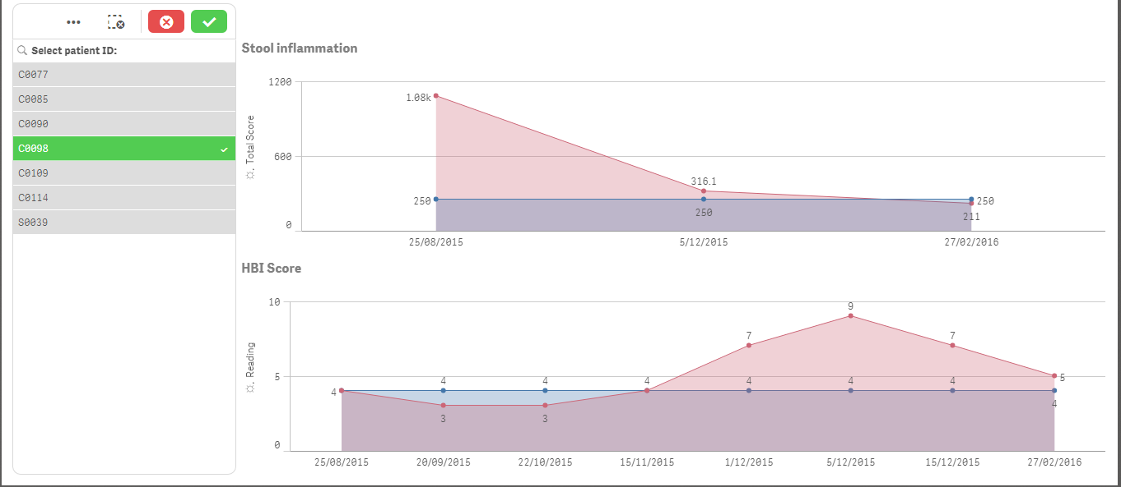
Clinician Insights

Slide 9
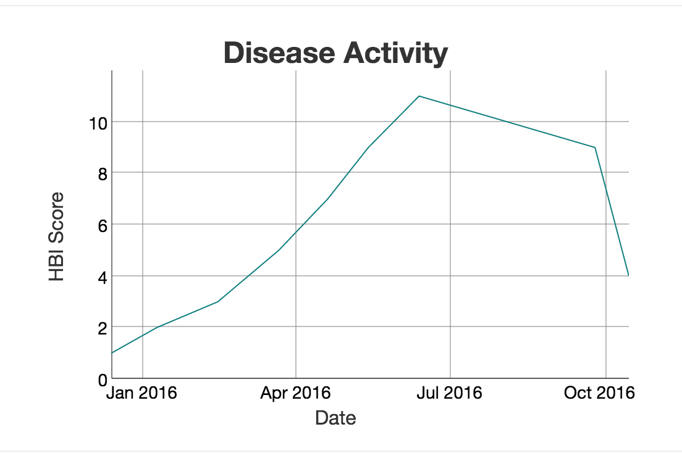
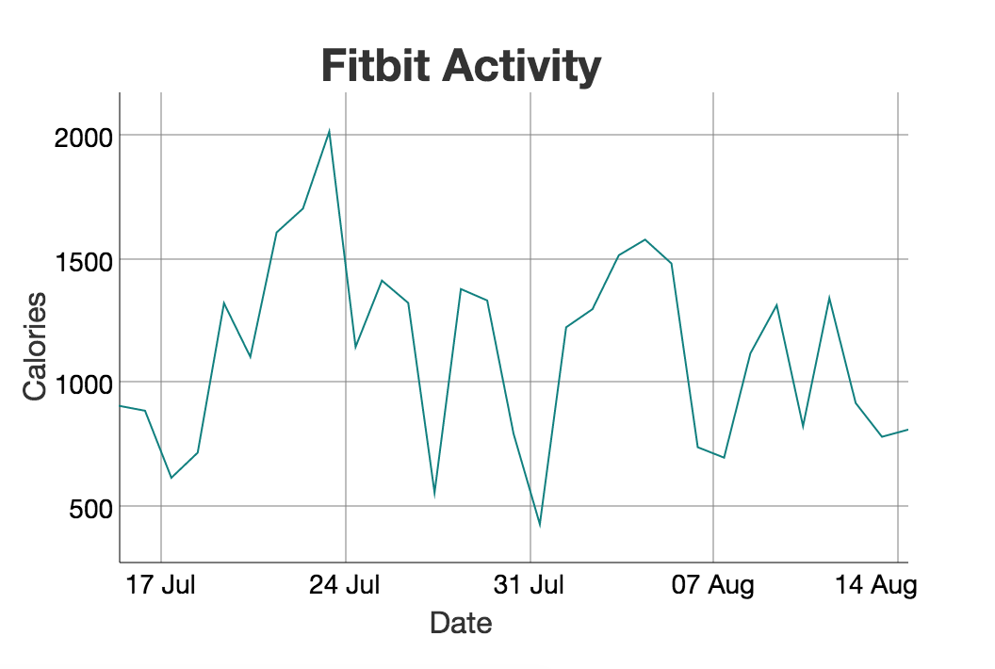
Patient Insights
https://www.wevegotguts.com

Slide 10
What Is Next?
Live integration with Wearable APIs (e.g. Fitbit, Apple Watch)
Social Logins and Patient Recorded Outcomes.
Mobile Push Notifications
Prediction of Disease behaviour through Machine Learning
Base Platform Created - We can cater for other conditions!!

